Slide 1
Project #3413
Sonar Signal Detection and Separation Based on Beam Pattern Analysis
Students: Ariel Jacobson (325553410) | Rom Barat (322911116)
Supervisor: Shaked Sasporta
Location: Israeli Navy Headquarters
Supervisor Approval: ____________
Tel Aviv University | Faculty of Engineering | School of Electrical Engineering

Slide 2
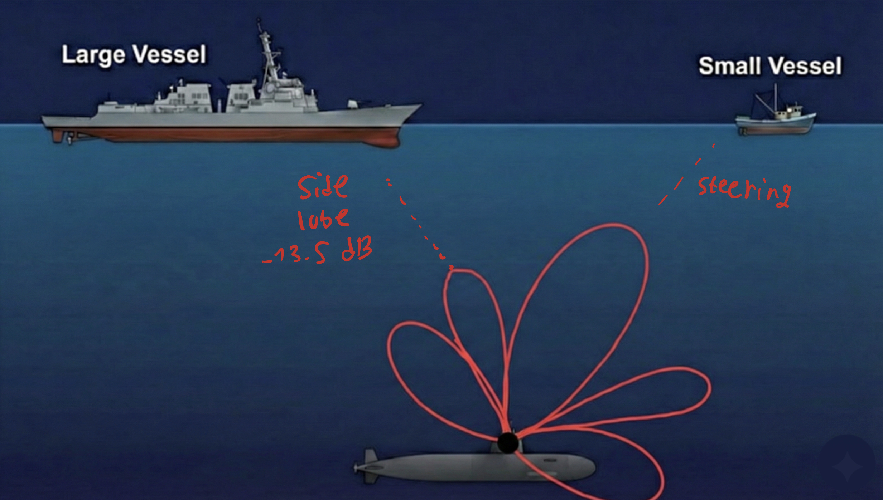
Introduction & The problem
The Challenge
In a multi-target environment, a loud source (Jammer/Interferer) creates significant energy leakage.
Sonar operators face information overload from multiple sources
The Critical Issue: A quiet target of interest is often completely hidden by the side-lobes of a louder neighbor.
Project Goal
Develop an algorithm for "speaker separation" in sonar context — distinguishing between different sound sources even when they overlap in intensity at a given direction, by leveraging the fact that they arrive from different angles.
Strategic Importance: Reduces operator cognitive load • Faster threat identification • Improved detection of masked targets

Slide 3
System Architecture
Acoustic
Input
Spatial
Filtering
Spectral
Analysis
ML
Detection
Separated
Audio (optional)
→
→
→
→
Sensor Array
(ULA)
Delay-and-Sum
Beamforming
Welch / BT
PSD
Counting and Seperation
Per-target
channels
Implementation Details
Spatial Filtering (Beamforming)
Uniform Linear Array (ULA) with 100 sensors
Delay-and-Sum algorithm with phase shifts
DOA scanning: -90° to +90°
Sub-sample delay via frequency domain
Detection & Separation (Planned)
SVM as baseline classifier
Neural network for improved accuracy
Spatial features + spectral features as input

Slide 4
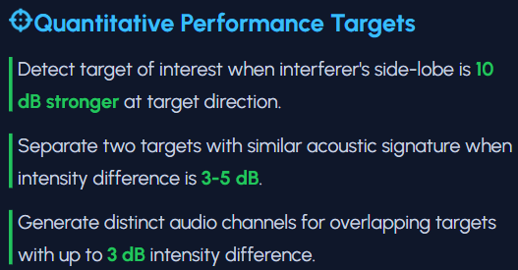
System Requirements & Deliverables
Simulation Environment
Detection Algorithm
Separation Output
ULA sensor array simulation
Delay-and-Sum beamforming
Acoustic propagation model
Configurable SNR & scenarios
ML-based target detection
Target vs. noise classification
Target counting algorithm
Spectral feature extraction
Separate audio per target
Spatial masking removal
Adaptive null-steering filter
Clean playback for operator
What Are We Simulating
We are building a Data Factory to train a Neural Network. The simulation replicates the exact physics of masking:
Scenario: A target enters through the "Side Lobe" of a Jammer.
The Problem: Conventional math cannot distinguish the target from the Jammer's leakage.
The Expectation: By generating thousands of these "impossible" scenarios, the model will learn the unique fingerprint of the array's side-lobes and filter them out.

Slide 5
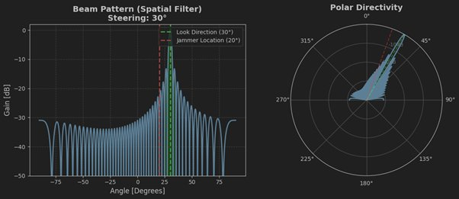
Stage 1: Spatial Filtering (Beamforming)
Key Observations
Main lobe steered to 30° (target direction)
Side lobes attenuated by ~13 dB
Jammer at 20° experiences ~20 dB attenuation
Polar view confirms directional selectivity
Physics Engine
Time delay based on angle θ
Phase-shift in frequency domain for precision

Slide 6
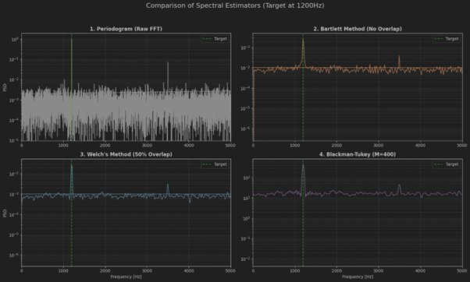
Stage 2: Spectral Estimation Methods
Method Comparison
1. Periodogram
High variance, hard to detect
2. Bartlett
Reduced variance, lower resolution
3. Welch ✓
Best SNR, clear 1200Hz peak
4. Blackman-Tukey ✓
Smoothest, ideal for counting
Selection: Welch's method for detection (lowest MSE) | Blackman-Tukey for visualization (smoothest curve)
Target at 1200 Hz clearly visible with Welch & Blackman-Tukey, while Periodogram shows only noise fluctuations

Slide 7
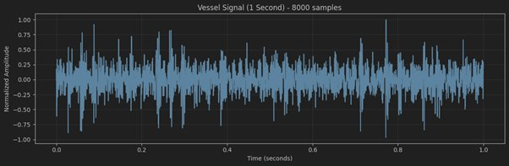
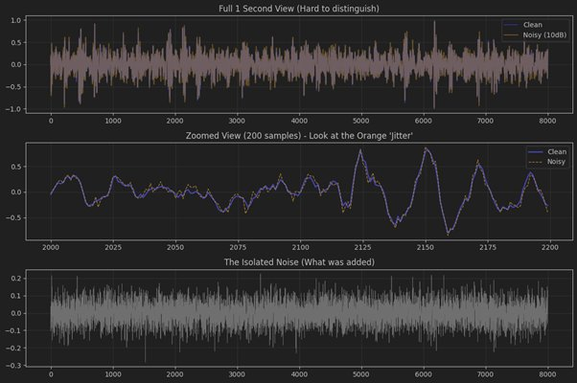
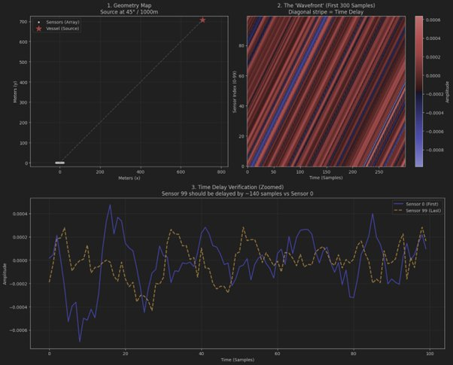
Simulation Pipeline Demo
Step 1: Audio Loading
1-second normalized vessel signal (8000 samples)
Step 2: Controlled Noise Injection
White Gaussian noise at SNR = 10 dB
Zoomed view reveals the "jitter" on the signal
Step 3: Sensor Array Simulation
100 sensors receive delayed copies of signal
Diagonal stripe = wavefront propagation
~140 sample delay between Sensor 0 and 99

Slide 8
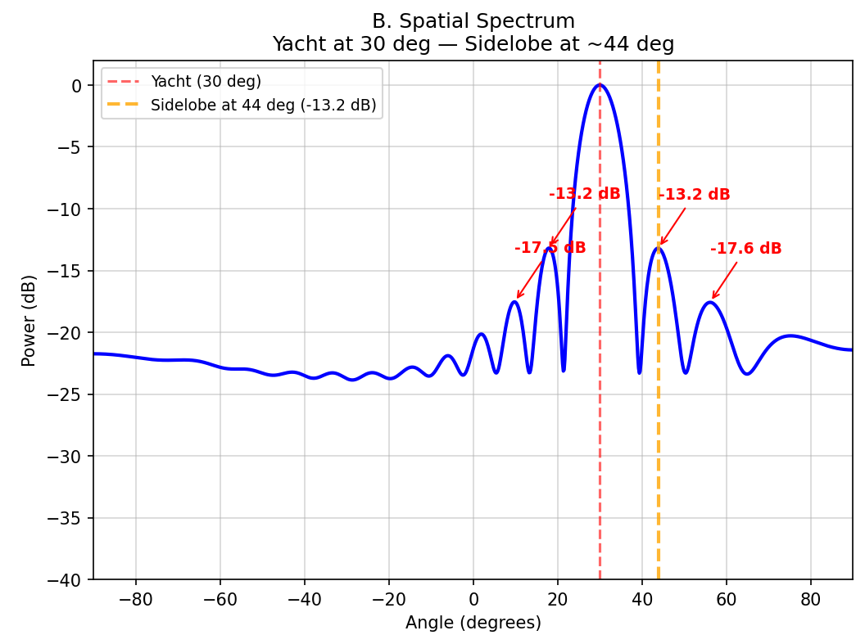
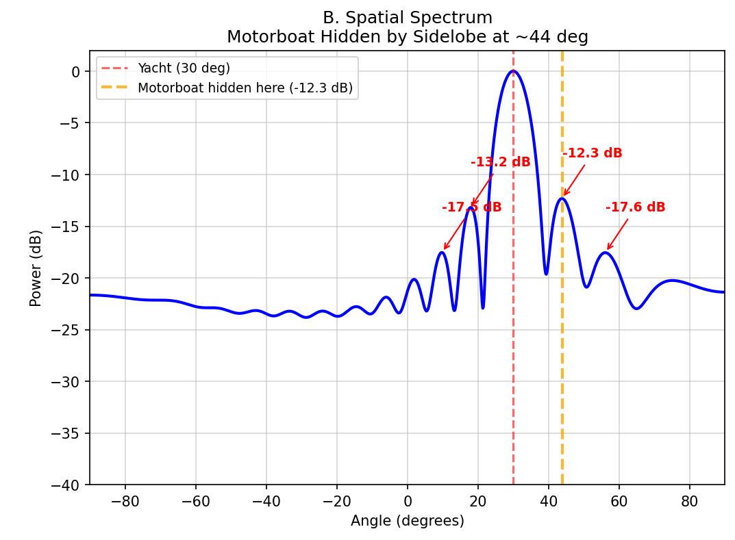
Limitation: The Sidelobe Masking Effect
Single Vessel at 30°
Two Vessels at -30° and 44°
Key Results
The strong Yacht signal dominates the energy map, obscuring the weaker Motorboat track.
The Motorboat peak (-12.3 dB) is indistinguishable from the Yacht's sidelobe (-13.2 dB).

Slide 9
Current Status & Progress
Completed
In Progress
✓ Theoretical background study
Acoustics, beamforming, spectral methods
✓ Simulation environment (Python)
ULA model, physics engine, beamformer
✓ Spectral estimation comparison
Selected Welch & Blackman-Tukey
✓ Multi-target scenario demonstration
Successfully generation a number of vessels at different angles
✓ Dataset generation
Synthesizing training data for ML models
◐ ML detection algorithem
Target vs. noise binary classification
○ Target counting algorithm
Estimating number of active sources
○ Audio separation output
Generating per-target audio channels
Technology Stack
Python | NumPy / SciPy (signal processing) | Matplotlib (visualization) | Scikit-learn / PyTorch (ML - planned)

Slide 10
Project Timeline
Milestone | Target Date | Actual Date | Notes
Theoretical background study | 15/11/2025 | 15/11/2025 | Completed
Basic Beamforming simulation | 30/11/2025 | 30/11/2025 | Completed
Spectral estimation | 14/12/2025 | 14/12/2025 | Completed
Dataset generation | 30/12/2025 | 30/12/2025 | Completed
Modeling and addition of noise | 14/01/2026 | 12/01/2026 | Completed
Full Simulation environment | 30/01/2026 | 25/01/2026 | Completed
Basic detector (Detection) | 28/02/2026 | To be Finished after the presentation | In progress
Mid-project presentation | 13/02/2026 | 13/02/2026 | Completed
Target counting algorithm | 20/03/2026 | To Be Done | To Be Done
Audio channel generation (optional) | 20/04/2026 | To Be Done | To Be Done
Stress testing | 05/05/2026 | To Be Done | To Be Done
Final report | 24/05/2026 | To Be Done | To Be Done
Final presentation & poster | 23/06/2026 | To Be Done | To Be Done

